Slide 1
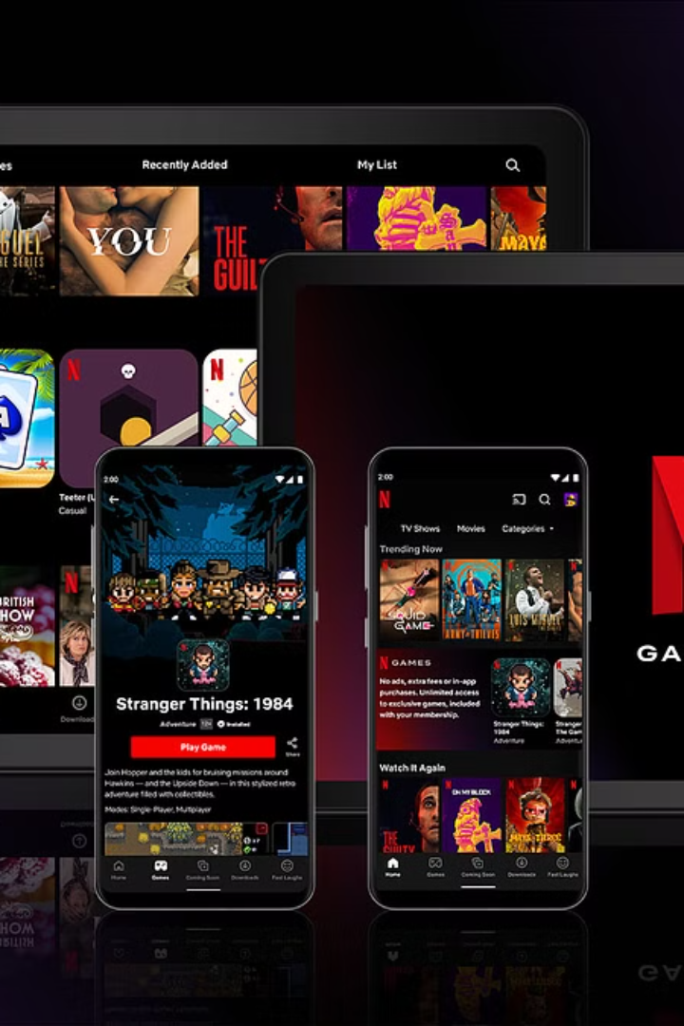

Netflix's System Design:
A Beginner-Friendly Explanation
Here's a beginner-friendly explanation of Netflix's System Design, simplified and easy to understand:
by Ram N Java

Slide 2
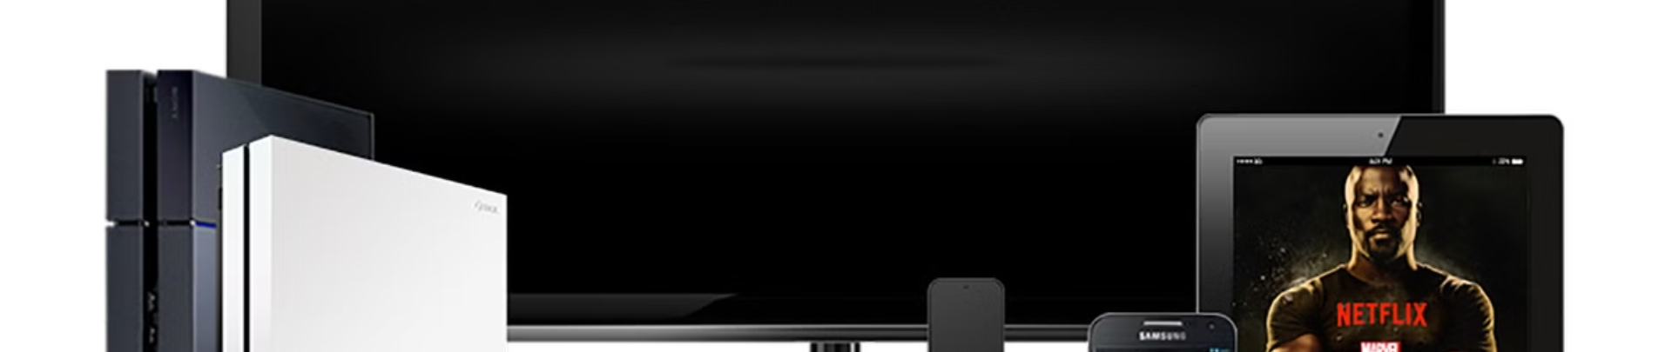
What Netflix Does
Video Streaming Service
On-Demand Viewing
Netflix is a platform that allows people worldwide to stream movies and TV shows anytime, on any device.
You can watch on demand (no waiting), in high quality, on devices like smartphones, laptops, TVs, and tablets.
But behind the scenes, it's a complex system that ensures you can watch your favorite content without interruptions. Let's break it down step by step.

Slide 3
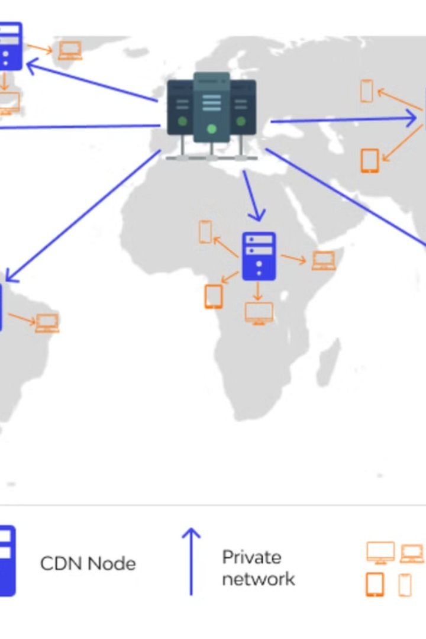



Key Components:
Content Delivery Network (CDN)
Fast Video Delivery
When you play a video, Netflix needs to deliver it quickly and smoothly.
Open Connect
Netflix uses its own CDN called Open Connect, a system of servers located in many places worldwide.
Faster Loading
These servers store Netflix videos close to where you are, so videos load faster and don't have to travel long distances over the internet.

Slide 4
Key Components:
Database for Users and Content
User Data
Content Data
Netflix has a huge database to store details about:
Information about:
Who you are
All movies
Your preferences
Shows
Watch history
Subtitles
Audio tracks
This helps Netflix recommend shows you might like and keep track of where you stopped watching.

Slide 5
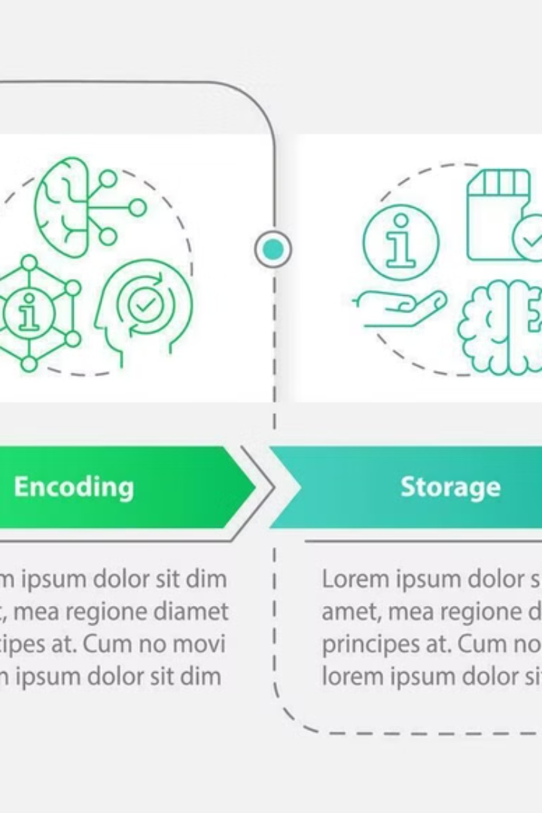
Key Components:
Video Encoding and Storage
Multiple Resolutions
Adaptive Playback
Videos on Netflix are stored in different resolutions (e.g., HD, 4K) and formats to suit different devices and internet speeds.
When you hit play, Netflix chooses the best video quality based on your internet speed and device.

Slide 6
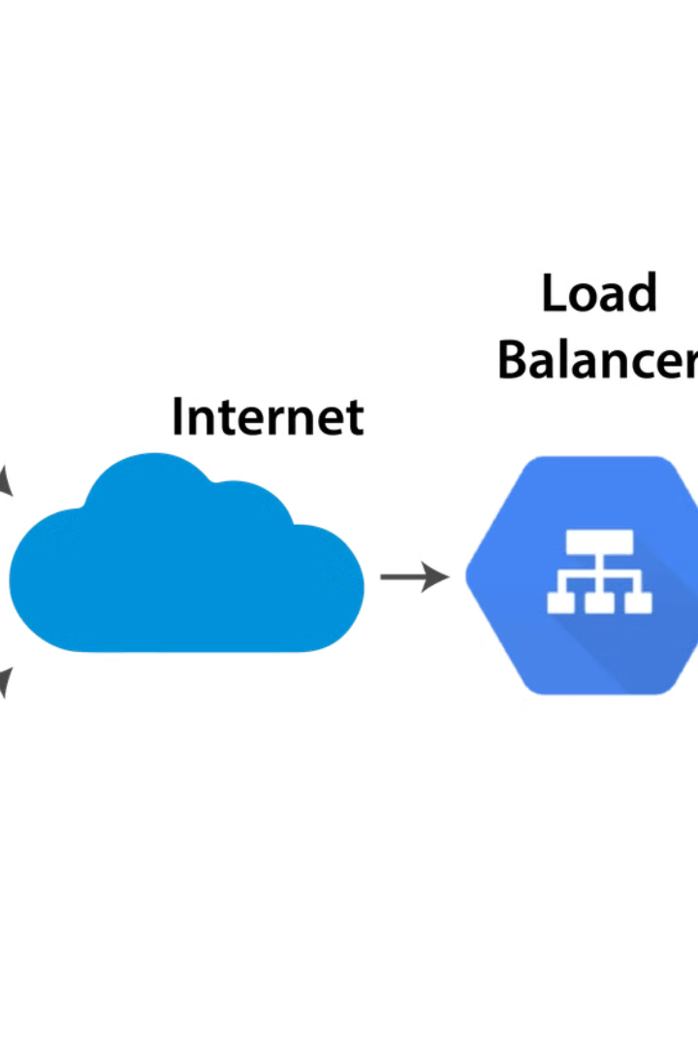


Key Components:
Streaming and Load Balancing
Multiple Servers
Redundancy
Netflix doesn't send the video directly from one central server. Instead, it uses multiple servers to share the load.
This ensures that even if one server is busy or down, another can step in, so you don't experience buffering.

Slide 7
Key Components: Recommendation System (AI/ML)
1
Data Analysis
Netflix uses Artificial Intelligence (AI) to analyze what you've watched, liked, or skipped.
2
Recommendation Engine
It suggests shows you'll enjoy using a recommendation engine based on your viewing habits.

Slide 8



Key Components: Scalability and Cloud
Cloud Services
1
Netflix uses cloud services (like AWS) to handle millions of users streaming at the same time.
Scalability
2
The system can scale up or down based on demand.
Demand Adaptation
3
More people watching during weekends? No problem!

Slide 9

How Netflix Handles Challenges
Buffering
Global Availability
Netflix uses techniques like adaptive streaming to adjust the video quality based on your internet speed, reducing buffering.
With servers worldwide, Netflix ensures content is accessible in almost every country.
Security
Downtime
Content is encrypted, so no one can steal or tamper with the videos.
Netflix uses multiple servers and redundancy to ensure you can watch even if some parts of the system fail.

Slide 10
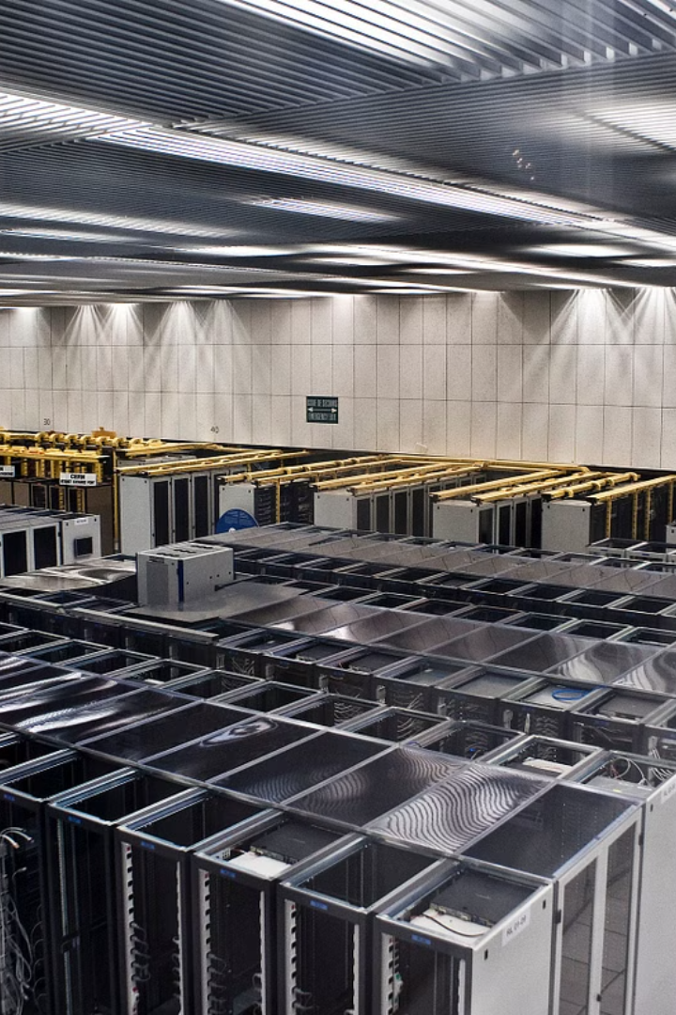


Why Netflix's System is Special
Personalization
Reliability
No two users have the same Netflix homepage.
Videos play smoothly, even during peak hours.
Quality
Content streams in the best quality your internet can handle.

Slide 11

Netflix's System Design: The Big Picture
In short, Netflix's system design is all about delivering videos quickly, smoothly, and reliably, no matter where you are or what device you're using. It's like a well-organized highway system where every user gets their own lane without traffic!

